Slide 1
fiction
Taught by Yossef Ayman Zedan

Slide 2
Navbar
We will take this navbar: https://getbootstrap.com/docs/5.1/components/navbar/#supported-content
Delete the form and move the content to the right side. Change brand and items
Add Sass and run it
We will edit the navbar color from: https://getbootstrap.com/docs/5.1/components/navbar/#sass ($ navbar-dark-color) We will make it to #facd8a

Slide 3

Carousel

Slide 4
Carousel
We will take this carousel: https://getbootstrap.com/docs/5.1/components/carousel/#crossfade and add caption <div class="carousel-caption d-none d-md-block"> <h5>First slide label</h5> <p>Some representative placeholder content for the first slide.</p> </div> for every single carousel-item
<div class="carousel-caption d-none d-md-block position-absolute top-50 mt-5 translate-middle-y">
<h1 class="display-3 fw-bolder fst-italic text-primary">Content</h1>
</div>

Slide 5
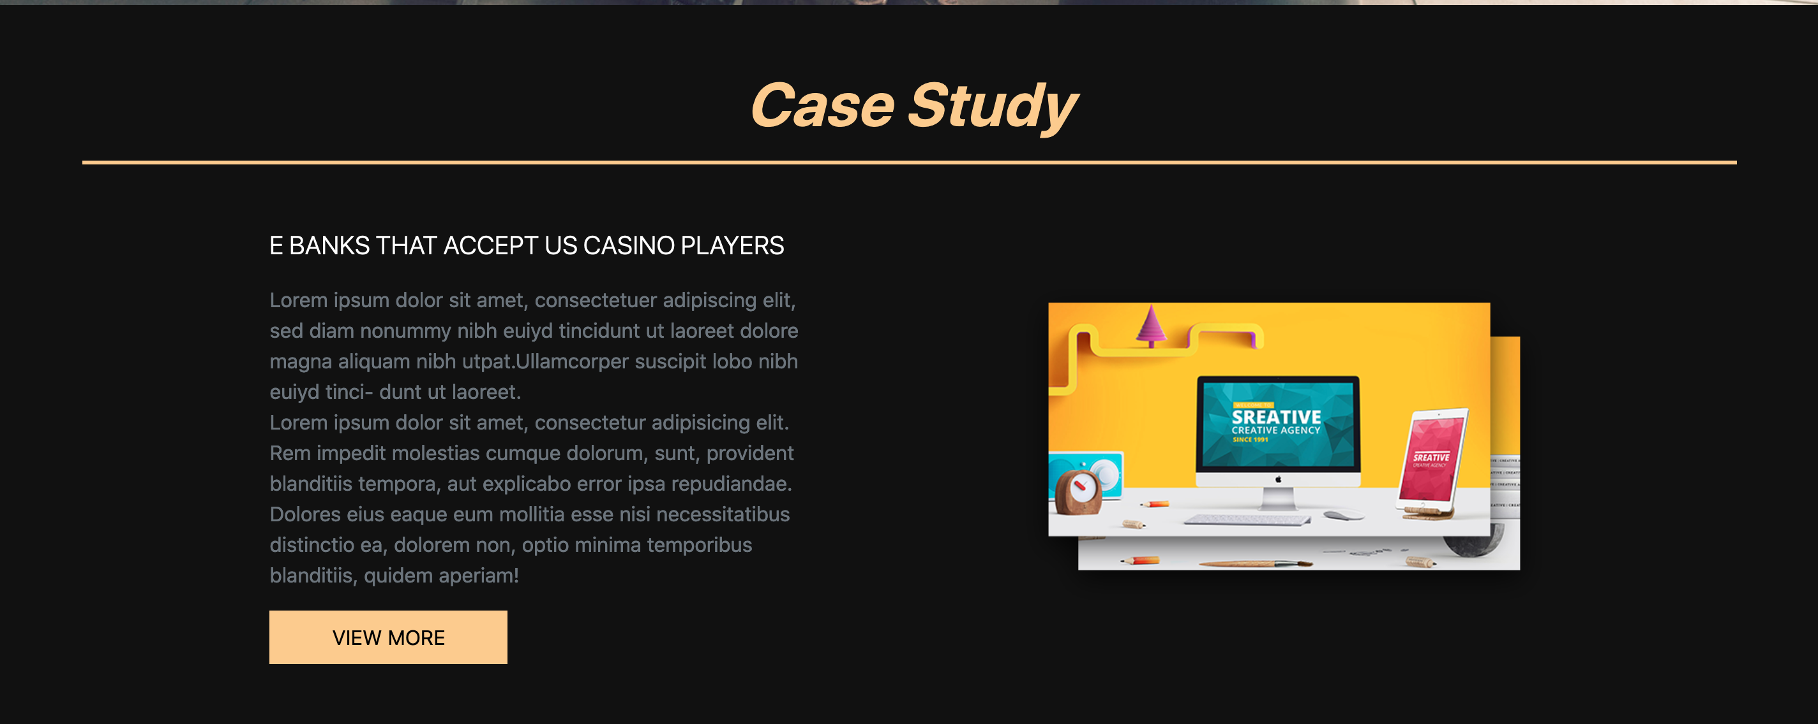
Case Study
First, add: section, container, then the case header with display-5, border-bottom primary and some styles
Border bottom primary is already different now because we edited primary in SCSS file

Slide 6
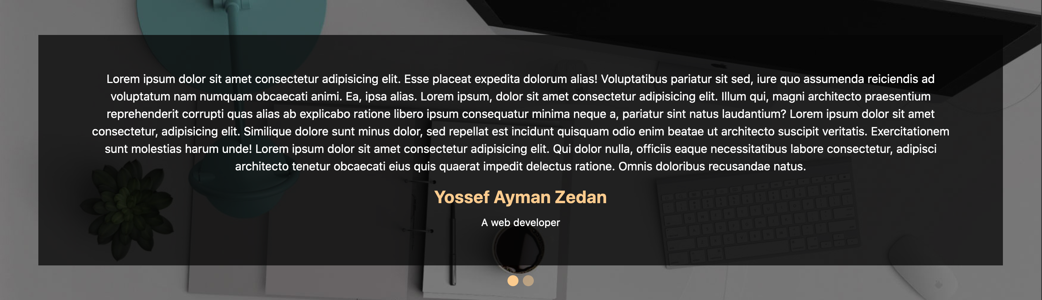
Carousel 2

Slide 7
Carousel 2
We will add: .clients {
background-image: url(bg-3.jpeg);
background-attachment: fixed;
background-size: cover;
} in Sass
We will use section, py-5 and the carousel from: https://getbootstrap.com/docs/5.1/components/carousel/#with-indicators and delete the arrows
We will go to https://getbootstrap.com/docs/5.1/components/carousel/#sass to edit Sass.
We will choose the indicators: $carousel-indicator-width: 15px;
$carousel-indicator-height: 15px;
$carousel-indicator-active-bg: #facd8a;

Slide 8
Carousel 2
Then add: rounded-circle to the indicators,<div class="carousel-indicators position-absolute" style="top: 101%;"> and some captions

Slide 9

Staff section
We will add container, title, row with g-0 and 8 col-lg-3

Slide 10
Footer
We will add: footer, container, the map from: https://www.embedmymap.com/
Then, div with text-center and py-5 with the copyright

